Slide 1



2160708
Web Technology
Unit-3
HTML
Prof. Arjun V. Bala
9624822202
arjun.bala@darshan.ac.in

Slide 2
Outline
Introduction to HTML
What is a Web Page?
My First HTML Page
HTML Code Formatting
Basic HTML Tags
Heading
Paragraph
Color
Font
List
Anchor
Image
HTML Tables
HTML Forms
XHTML
Introduction to HTML 5

Slide 3
What is a Web Page?
Web page is text file containing HTML
HTML – Hyper Text Markup Language
A notation for describing
document structure (semantic markup)
formatting (presentation markup)
The markup tags provide information about the page content structure

Slide 4
Creating HTML Pages
An HTML file must have an .htm or .html file extension
HTML files can be created with text editors:
NotePad, NotePad ++, PSPad
Or HTML editors (WYSIWYG Editors):
Microsoft FrontPage
Macromedia Dreamweaver
Netscape Composer
Visual Studio

Slide 5
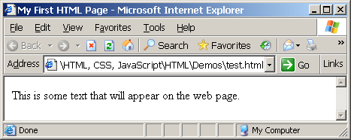
First HTML Page
test.html
<html>
<head>
<title>My First HTML Page</title>
</head>
<body>
<p>This is some text...</p>
</body>
</html>

Slide 6
HTML Structure
HTML is comprised of “elements” and “tags”
Begins with <html> and ends with </html>
Elements (tags) are nested one inside another:
Tags have attributes:
HTML describes structure using two main sections: <head> and <body>
<html> <head></head> <body></body> </html>
<img src="logo.jpg" alt="logo" />

Slide 7
HTML Code Formatting
The HTML source code should be formatted to increase readability and facilitate debugging.
Every block element should start on a new line.
Every nested (block) element should be indented.
Browsers ignore multiple whitespaces in the page source, so formatting is harmless.
For performance reasons, formatting can be sacrificed

Slide 8
First HTML Page: Tags
<!DOCTYPE HTML>
<html>
<head>
<title>My First HTML Page</title>
</head>
<body>
<p>This is some text...</p>
</body>
</html>
Opening tag
Closing tag
An HTML element consists of an opening tag, a closing tag and the content inside.

Slide 9
First HTML Page: Header
HTML header
<!DOCTYPE HTML>
<html>
<head>
<title>My First HTML Page</title>
</head>
<body>
<p>This is some text...</p>
</body>
</html>

Slide 10
First HTML Page: Body
<!DOCTYPE HTML>
<html>
<head>
<title>My First HTML Page</title>
</head>
<body>
<p>This is some text...</p>
</body>
</html>
HTML body

Slide 11
First HTML Page
test.html
<!DOCTYPE HTML>
<html>
<head>
<title>My First HTML Page</title>
</head>
<body>
<p>This is some text...</p>
</body>
</html>

Slide 12
Basic HTML Tags
Headings
Paragraph
Colors
Fonts
List
Anchor Tag
Image
Table
Form

Slide 13
1) Headings
Headings are important because search engines use the headings to index the structure and content of your web pages.
<h1> text </h1> -- largest of the six
<h2> text </h2>
<h3> text </h3>
<h4> text </h4>
<h5> text </h5>
<h6> text </h6> -- smallest of the six
align="position" --left (default), center or right

Slide 14
2) <p> paragraph
<p> defines a paragraph
Add align="position" (left, center, right)
Multiple <p>'s do not create blank lines
Use <br> for blank line
Fully-specified text uses <p> and </p>, but </p> is optional

Slide 15
3) Colors
Values for bgcolor and color
many are predefined (red, blue, green, ...)
all colors can be specified as a six character hexadecimal value: #RRGGBB
#FF0000 – red
#888888 – gray
#00FF00 –green
#000000 – black

Slide 16
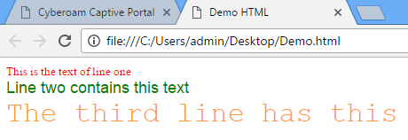
4) Fonts
The <font> tag specifies the font face, font size, and color of text.
The <font> tag is not supported in HTML5.
<font color="red" size="2" face="Times Roman">
This is the text of line one </font>
<font color="green" size="4" face="Arial">
Line two contains this text </font>
<font color="#FF9933" size="6" face="Courier“>
The third line has this additional text </font>

Slide 17
5) List
Ordered List
Block-A
Block-B
Block-C
Block-D
Unordered List
Block-A
Block-B
Block-C
Block-D
Block-A
Block-B
Block-C
Block-D
Block-A
Block-B
Block-C
Block-D
Block-A
Block-B
Block-C
Block-D
Block-A
Block-B
Block-C
Block-D
Block-A
Block-B
Block-C
Block-D
Block-A
Block-B
Block-C
Block-D

Slide 18
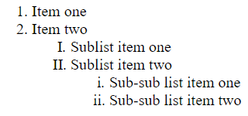
5.1) Ordered List
<ol>
<li> Item one </li>
<li> Item two </li>
<ol type="I" >
<li> Sublist item one </li>
<li> Sublist item two </li>
<ol type="i">
<li> Sub-sub list item one </li>
<li> Sub-sub list item two </li>
</ol>
</ol>
</ol>
Types:
Type = 1 (default)
Type = a
Type = A
Type = I
Type = i
Output

Slide 19
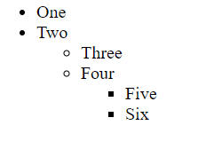
5.2) Unordered List
<ul>
<li> One </li>
<li> Two </li>
<ul type="circle">
<li> Three </li>
<li> Four </li>
<ul type="square">
<li> Five </li>
<li> Six </li>
</ul>
</ul>
</ul>
Types:
Type = disc (default)
Type = circle
Type = square
Output

Slide 20
6) <a> Anchor Tag (Hyperlinks)
The <a> tag defines a hyperlink, which is used to link from one page to another.
Link to an absolute URL:
If you get spam, contact <a href="http://www.microsoft.com">
Microsoft </a> to report the problem.
Link to a relative URL:
See these <a href=“./index.php"> references </a>
concerning our fine products.
Link to a section within a URL:
<a href=“#reference">
Reference Section. </a>

Slide 21
7) Images
Syntax :
<img src=“PathToImage”/>
src is required
alt will specify the text to display if the Image not found
width, height may be in units of pixels or percentage of page or frame
width="357"
height="50%“

Slide 22
Images (cont.)
<img src="dolphin.jpg" align="left" width="150" height="150" alt="dolphin jump!">
align=position | Image/Text Placement
Left | Image on left edge; text flows to right of image
Right | Image on right edge; text flows to left
Top | Image is left; words align with top of image
Bottom | Image is left; words align with bottom of image
Middle | Words align with middle of image

Slide 23
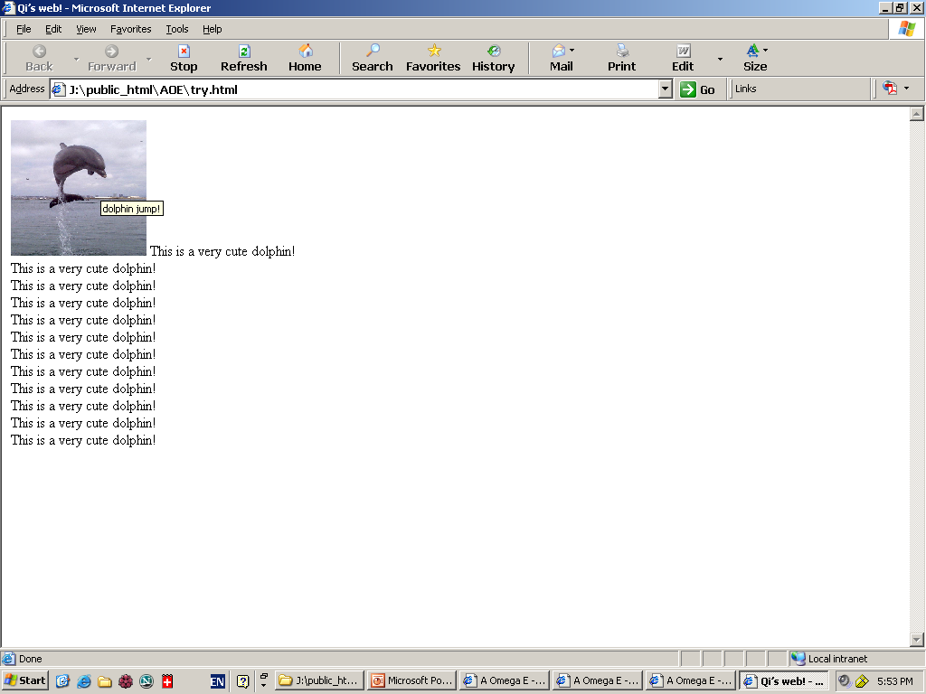
Image (cont.) => align=“bottom”

Slide 24
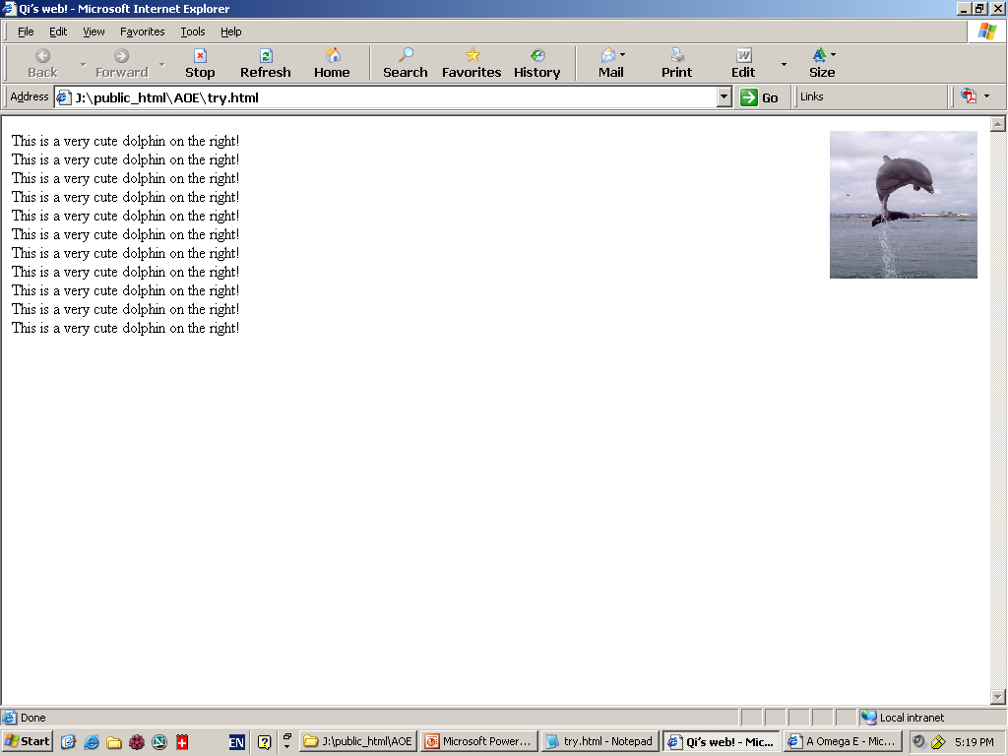
Image (cont.) => align=“right”

Slide 25
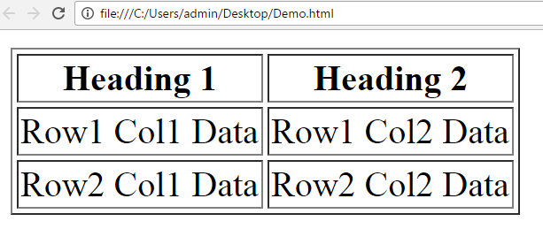
8) Table
<table> table tag
<caption> optional table title
<tr> table row
<th> table column header
<td> table data element
<table border=1>
<caption>Table Caption</caption>
<tr>
<th>Heading1</th>
<th>Heading2</th>
</tr>
<tr>
<td>Row1 Col1 Data</td>
<td>Row1 Col2 Data</td>
</tr>
<tr>
<td>Row2 Col1 Data</td>
<td>Row2 Col2 Data</td>
</tr>
</table>

Slide 26
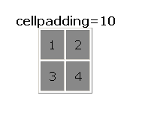
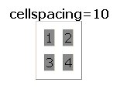
Table Element Attributes
align=position -- left, center, right for table
border=number -- width in pixels of border (default 0)
cellspacing=number -- spacing in pixels between cells, default about 3
cellpadding=number -- space in pixels between cell border and table element, default about 1
width=number[%]-- width in pixels or percentage of page/frame width

Slide 27
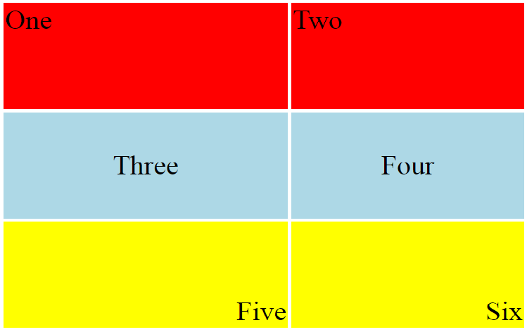
Table Row <tr> Attributes
Valid for the table row:
align -- left, center, right
valign -- top, middle, bottom
bgcolor -- background color
<table align="center" width="300" height="200">
<tr align="left" valign="top" bgcolor="red">
<td>One</td>
<td>Two</td>
</tr>
<tr align="center" valign="middle" bgcolor="lightblue">
<td>Three</td>
<td>Four</td>
</tr>
<tr align="right" valign="bottom" bgcolor="yellow">
<td>Five</td>
<td>Six</td>
</tr>
</table>

Slide 28
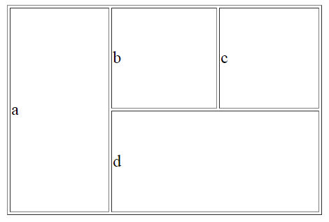
Irregular Table
a
b
c
Valid for the table cell:
colspan
- how many columns this cell occupies
rowspan
- how many rows this cell occupies
<table align="center" width="300" height="200" border="1">
<tr>
<td colspan="1" rowspan="2">a</td>
<td colspan="1" rowspan="1">b</td>
<td colspan="1" rowspan="1" >c</td>
</tr>
<tr>
<td colspan=“2" rowspan="1">d</td>
</tr>
</table>
d

Slide 29
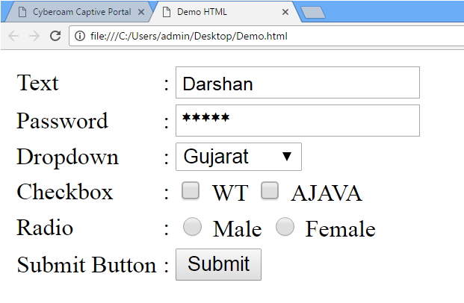
9) HTML Form
<form> is just another kind of HTML tag
HTML forms are used to create GUIs on Web pages
Usually the purpose is to ask the user for information
The information is then sent back to the server
A form is an area that can contain form elements
The syntax is: <form parameters> ...form elements... </form>
Form elements include: buttons, checkboxes, text fields, radio buttons, drop-down menus, etc
Other kinds of HTML tags can be mixed in with the form elements
A form usually contains a Submit button to send the information in the form elements to the server
The form’s parameters tell browser how to send the information to the server (there are two different ways it could be sent)

Slide 30
The <form> Tag
The <form arguments> ... </form> tag encloses form elements (and probably other HTML as well)
The arguments to form tell what to do with the user input
action="url" (required)
Specifies where to send the data when the Submit button is clicked
method="get" (default)
Form data is sent as a URL with ?form_data info appended to the end
Can be used only if data is all ASCII and not more than 100 characters
method="post"
Form data is sent in the body of the URL request
Cannot be bookmarked by most browsers
target="target"
Tells where to open the page sent as a result of the request
target= _blank means open in a new window
target= _top means use the same window

Slide 31




Input tags
Text field
Example: <input type=“text” name=“inputname”/>
Password field
Example: <input type=“password” name=“inputname”/>
Radio buttons
Example:
<input type="radio" name="gender"> Male
<input type="radio" name="gender"> Female
Check boxes
Example:
<input type="checkbox" name="Roll1"> Roll No 1 <br/>
<input type="checkbox" name="Roll2"> Roll No 2 <br/>
<input type="checkbox" name="Roll3"> Roll No 3 <br/>

Slide 32
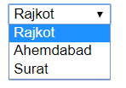
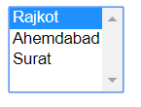
Input tags (cont.)
Dropdown list
<select> tag is used to create a drop-down list in HTML.
<option> tags inside the <select> tag define the available options in the list.
Example:
<select>
<option value=“1”>Rajkot</option>
<option value=“2”>Ahemdabad</option>
<option value=“3”>Surat</option>
</select>
Example (multiple select):
<select multiple="multiple">
<option value=“1”>Rajkot</option>
<option value=“2”>Ahemdabad</option>
<option value=“3”>Surat</option>
</select>

Slide 33
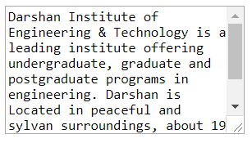

Input tags (cont.)
Text area
<textarea> tag defines a multi-line text
input control.
Example :
<textarea rows=“8” cols=“30”>
Darshan Institute of Engineering & Technology is a leading institute ….
</textarea>
Submit Button
Submit button is used to submit the data
to the form action url.
Example :
<input type=“submit” value=“Add City”>

Slide 34

Unit - 3 XHTML
Prof. Arjun Bala
9624822202
arjun.bala@darshan.ac.in
Web Technology
2160708
Semester 6
Computer Engineering Darshan Institute of Engineering & Technology

Slide 35
Introduction to XHTML
Problems were initially caused in the development of HTML by a lack of standards.
Browser makers tended to add proprietary extensions that limited those who could see the sites in the way that was intended .
This was been termed the “browser wars” of 1990s.
The World Wide Web Consortium (W3C) became the main source for standards that browsers were to follow.

Slide 36
Introduction to XHTML (Cont.)
The evolution of HTML led to the separation of formatting instructions from content, leading to the development of CSS.
HTML was redeveloped as XHTML, using XML to apply more strict approach to web coding.
XHTML provides a more stable platform for CSS

Slide 37
XHTML
XHTML stands for EXtensible HyperText Markup Language
XHTML is almost identical to HTML 4.01
XHTML is a stricter and cleaner version of HTML 4.01
XHTML is HTML defined as an XML application
XHTML is supported by all major browsers.

Slide 38
Characteristics of XHTML
DOCTYPE is mandatory
XML namespace attribute in <html> is mandatory
<html>, <head>, <title>, and <body> is mandatory
elements must be properly nested
elements must always be closed
elements must be in lower case
documents must have one root element
Attribute names must be in lower case
Attribute values must be quoted
Attribute abbreviation is forbidden

Slide 39
XHTML DOCTYPE
An XHTML document must have an XHTML DOCTYPE declaration.
XHTML 1.0 document type definitions are corresponds to four Dtds:
Strict
Basic
Transitional
Frameset
The most commonly used is the XHTML Transitional document.

Slide 40
XHTML DOCTYPE (Cont.)
This DTD contains all HTML elements and attributes, but does NOT INCLUDE presentational or deprecated elements (like font). Framesets are not allowed.
XHTML 1.0 Strict:
<!DOCTYPE html
PUBLIC "-//W3C//Dtd XHTML 1.0 Strict//EN"
"http://www.w3.org/tr/xhtml1/Dtd/xhtml1-strict.dtd">
XHTML 1.0 Transitional:
<!DOCTYPE html
PUBLIC "-//W3C//Dtd XHTML 1.0 Transitional//EN"
"http://www.w3.org/tr/xhtml1/Dtd/xhtml1-transitional.dtd">
XHTML 1.0 Basic:
<!DOCTYPE html
PUBLIC "-//W3C//Dtd XHTML 1.0 Basic//EN"
"http://www.w3.org/tr/xhtml1/Dtd/xhtml1-basic10.dtd">
XHTML 1.0 Frameset:
<!DOCTYPE html
PUBLIC "-//W3C//Dtd XHTML 1.0 Frameset//EN"
"http://www.w3.org/tr/xhtml1/Dtd/xhtml1-frameset.dtd">
This DTD contains all HTML elements and attributes, INCLUDING presentational and deprecated elements (like font). Framesets are not allowed.
This DTD is equal to XHTML 1.0 Strict, but allows you to add modules (for example to provide ruby support for East-Asian languages).
This DTD is equal to XHTML 4.01 Transitional, but allows the use of frameset content.

Slide 41
XHTML Document Structure
A basic XHTML document consists of the following main parts:
xml version
The DOCTYPE (Dtd)
html document root
xmlns attribute for the html element
head element with a child title element
body element

Slide 42
XHTML Document Structure (Ex.)
<?xml version="1.0" ?>
<!DOCTYPE HTML PUBLIC "-//W3C//Dtd XHTML 1.00 Strict//EN" "http://www.w3.org/tr/xhtml1/Dtd/xhtml1-strict.dtd">
<html xmlns="http://www.w3.org/1999/xhtml">
<head>
<title>Hello</title>
</head>
<body>
helloooooooo
</body>
</html>

Slide 43
META Tag
Metadata is data (information) about data.
The <meta> tag provides metadata about the HTML document.
Metadata will not be displayed on the page.
Meta elements are typically used to specify page description, keywords, author of the document, last modified and other metadata.
The metadata can be used by search engines (keywords), browsers (how to display content or reload page) or other web services.

Slide 44
Meta Tag Attributes
Attribute | Value | Description
Charset | Character_set | Specifies the character encoding for the HTML document
name | author description keywords robots expires | Specifies a name for the metadata
http-equiv | content-type default-style refresh | Provides an HTTP header for the information/value of the content attribute
content | text | Gives the value associated with the http-equiv or name attribute
scheme | format/URI USA/Europe | Not supported in HTML5. Specifies a scheme to be used to interpret the value of the content attribute

Slide 45
Character Entities
Character entities are used to display reserved characters in HTML.
Characters that are not present on your keyboard can also be replaced by entities.
Character | Character Entity | Description
 | &nbsp; | Space
& | &amp; | Ampersand
“ | &quot; | Quote
< | &lt; | Less than
> | &gt; | Greater than
© | &copy; | Copyright
® | &reg; | Registered
™ | &trade; | Trademark
£ | &pound; | Pound
¢ | &cent; | Cent
÷ | &divide; | Divide

Slide 46
How Browser Works ?
Keyboard and Mouse
Output
To
Display
Controller
HTML Interpreter
Display
Drivers
Plug-Ins/
Other Interpreter
Response from web server
Network Interface
Other Clients
HTTP Client
Communication with web server

Slide 47
Introduction to HTML 5
The DOCTYPE declaration for HTML5 is very simple:
<!DOCTYPE html>
The character encoding (charset) declaration is also very simple:
<meta charset="UTF-8">
New HTML5 Elements:
New semantic elements like <header>, <footer>, <article>, and <section>.
New form control attributes like number, date, time, calendar, and range.
New graphic elements: <svg> and <canvas>.
New multimedia elements: <audio> and <video>.
Some Elements Removed in HTML5

Slide 48
Introduction to HTML 5 (cont.)
The following HTML4 elements have been removed from HTML5:
HTML 4 | HTML 5
<acronym> | <abbr>
<applet> | <object>
<center> | CSS
<dir> | <ul>
<font> | CSS
HTML 4 | HTML 5
<strike> | CSS
<tt> | CSS
<basefont> | CSS
<big> | CSS

